Slide 1
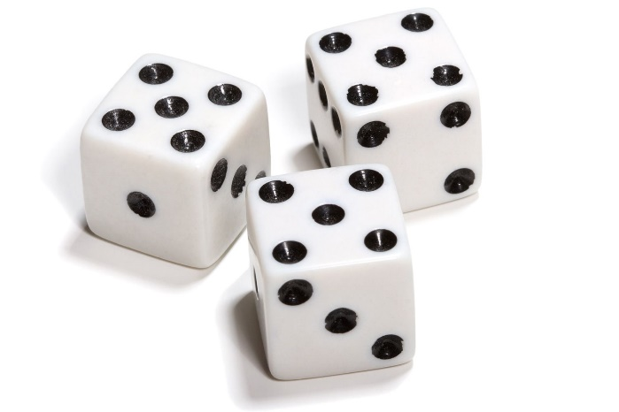
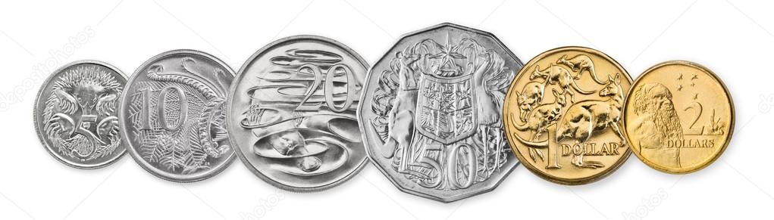
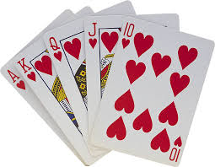
My Probability Interactive Notebook
Name
Class
Teacher
Term 4 Semester 2
1

Slide 2
Warm Up Dice Bingo
Draw a 3 x 3 table.
Two dice will be rolled. The uppermost faces then added together. Write the totals you think will come up.
You may use the same number more than once, but can only cross one number each go.

Slide 3
Contents
Glossary or Formula Page
Page
Date
Description
2
3

Slide 4
Tasks
24
7
30
Essential Question
Questions
Notes
Summary
4
5

Slide 5
Consider the following
Have a think about the following questions.
Do you like football?
Do you like music?
I might be interested to find out if people liked both (or neither).
So let’s set it up like this…
 | Like M | Dislike M
Like F
Dislike F
Total
Total
This is a two-way table!!!

Slide 6
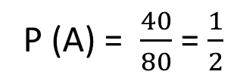
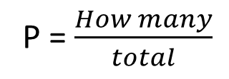
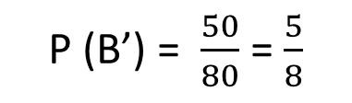
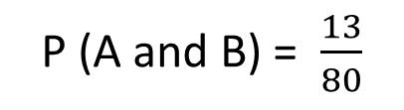
24
7
30
Date
Two-Way Tables
EQ – How can obtain probabilities from a two-way table?
What is a two-way table?
Two-way tables lists the number of outcomes (or people) in different categories, with totals at the bottom.
We display them like this.
Not A
 |  | Event A
 |  | A | A’ | Total
Event B | B
 | B’
 | Total
13
17
30
27
23
50
40
40
80
How do we find probabilities?
P = $\frac{How many}{total}$
P (A) = $\frac{40}{80}$ = $\frac{1}{2}$
P (A and B) = $\frac{13}{80}$
P (B’) = $\frac{50}{80}$ = $\frac{5}{8}$
7

Slide 7
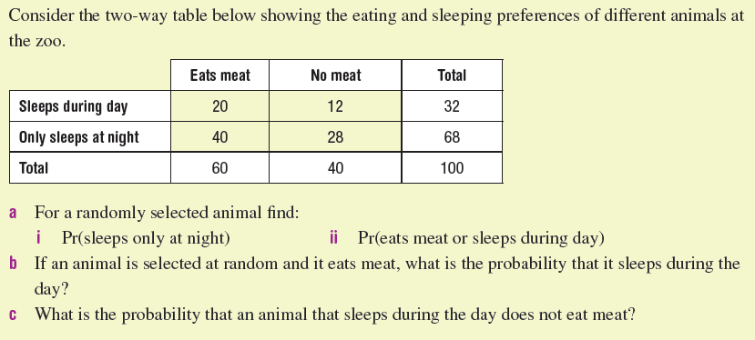
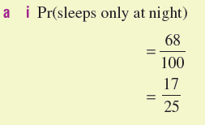
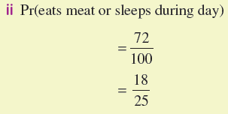
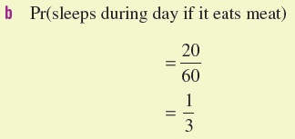

Let’s try this together

Slide 8
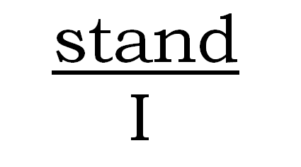
Do you understand?
Notes:
Check for Understanding

Slide 9
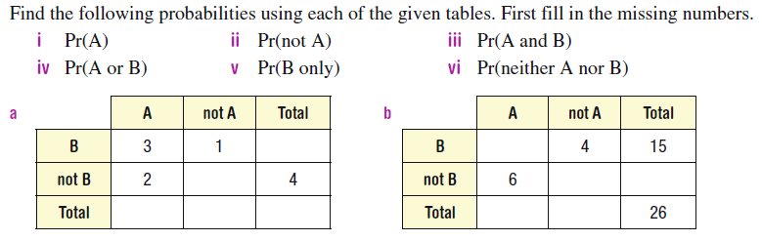
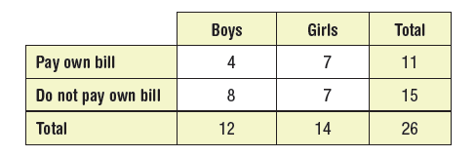
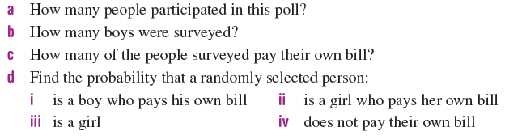
Your Turn (LHS)

